Slide 1
votos dapp

Slide 2
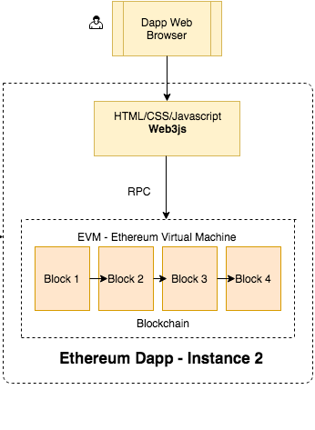

Slide 3
TECNOLOGÍAS USADAS
Ganache Cli
Metamask
Web3js
Solidity
Flutter
Mocha
HTML/ CSS BOOTSTRAP

Slide 4
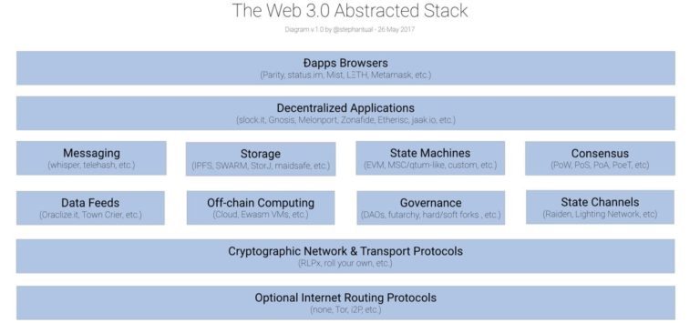
To make your app work on Ethereum, you can use the web3 object provided by the web3.js library.
Under the hood it communicates to a local node through RPC calls. web3.js works with
any Ethereum node, which exposes an RPC layer.

